Slide 1
Machine learning for BNE
Brazil Nut Effect Simulation and Machine Learning Pipeline
Notes:
Are your classroom colors different than what you see in this template? That’s OK! Click on Design -> Variants (the down arrow) -> Pick the color scheme that works for you!
Feel free to change any “You will…” and “I will…” statements to ensure they align with your classroom procedures and rules!

Slide 2
Research Pipeline
Data Generation
Feature Preparation
Model Comparison & Testing
Model
Development
& Training

Slide 3
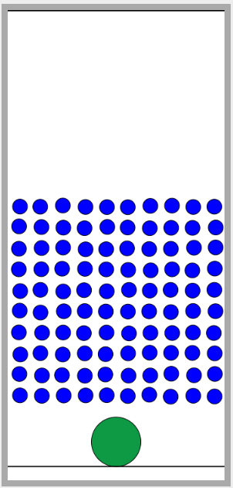
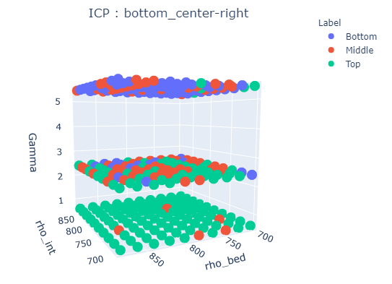
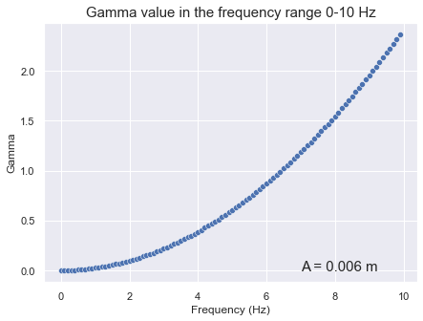
Data Generation
Randomly generated variables:
<FIX>The initial horizontal position of the intruder, will result in a different system configuration before the vibration begins. Contactopy.
Density of intruder and bed, each will be generated randomly with a range 700-1400. The diameter will be fixed in a ratio of 0.02:0.006.
The frequency will be chosen randomly with a range of 0-10 Hz. The amplitude is fixed so that the Gamma value will range between: 0-2.5.
At first stage we will generate 1000 simulation.
Model
Development
& Training

Slide 4
Feature Preparation
Calculate Gamma
Scaling and normalization features:
Gamma
Contactopy
Intruder horizontal position (x_{intruder}/x_{container})
Intruder and bed density
Labeling final vertical position of intruder:
y_{intruder} < 25% height : bottom
25% < y_{intrueder} < 75% : middle
75% < y_{intruder} : top
Model
Development
& Training

Slide 5
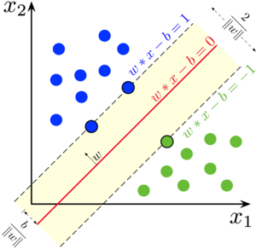
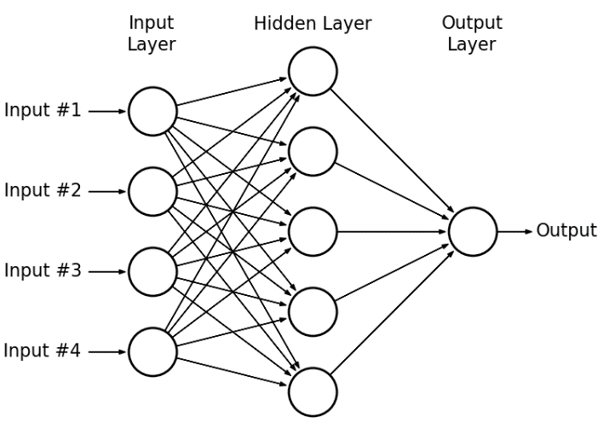
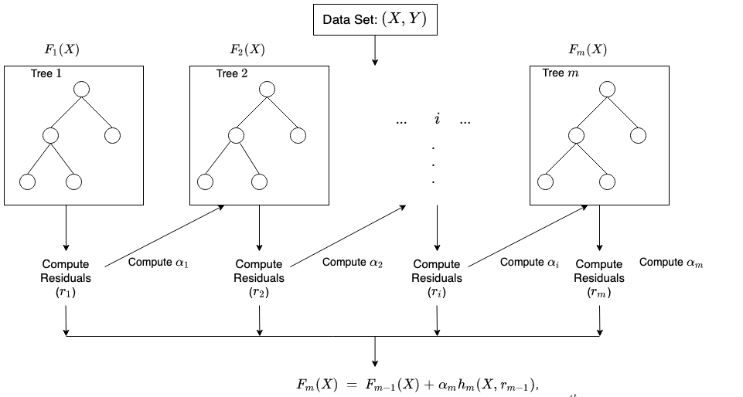
Model Development and Training
For this project, we will develop and train three kind of classification model:
Support Vector Machine
Artificial Neural Network (Multilayer Perceptron)
XGBoost
Model
Development
& Training
SVM
ANN
XGBoost
https://eigenvector.com/wp-content/uploads/2020/03/Wise_APACT_Nonlinear_Comparison.pdf

Slide 6
Thank you

